Slide 1
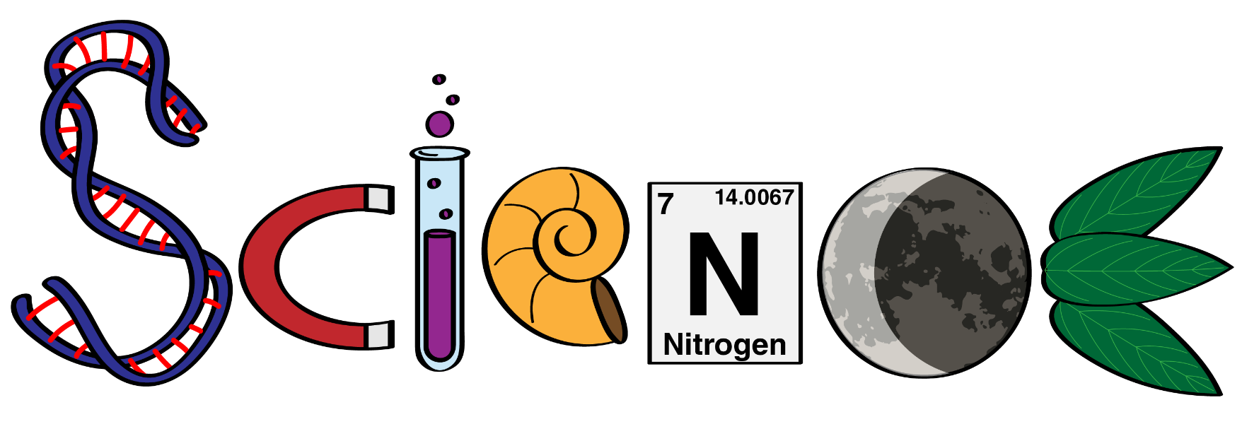
Course Selection
Junior Year

Slide 2
Chemistry is the study of Matter and the Changes it undergoes.
Advanced Chemistry: Highest Level of first year chemistry. This course is more rigorous and covers more topics than the academic chemistry class. This course will prepare students for college chemistry and AP chemistry. This course is for students who have excelled in biology.
Academic Chemistry: This is the level of chemistry that the majority of the student population take. This course will give students a general understanding of many chemical principles.
ChemCom: This chemistry course is designed with practical applications and limited math. This course does NOT prepare you for college chemistry or nursing school.

Slide 3
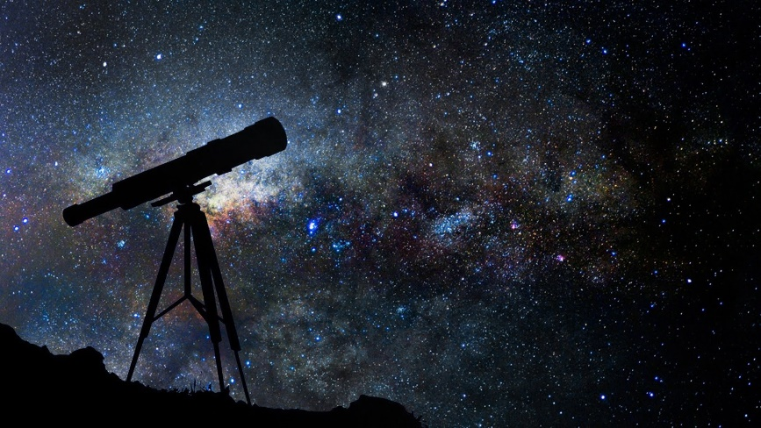
What is Astronomy? Get Excited! It’s out of this world fun!
There are tests and projects.
You will need to study.
You will have to take notes and read – I know you hate it =)
You do need to know basic math.
It’s the study of the cosmos, that means everything!
You’ll learn the following:
Distances in Space!
Finding objects in the sky other than the Big Dipper!
Ancient dead people and their contributions to astronomy
Where stars come from
Life on Earth and maybe other planets! – you design your own planet!,
Space Exploration and the future of Space Travel--We’re going to Mars people!!!

Slide 4
WhAT IS Waters of the World?
WOW is the study of how water shapes our planet and supports life.
You will learn the following:
The Hydrologic Cycle
Rivers, Lakes, and Streams.
Glaciation
Earth’s Oceans

Slide 5
What is Environmental Science?
Integrates physical, biological and information sciences to the study of the environment, and the solution of environmental problems.
Atmosphere problems (Greenhouse Gas)
Water & Air Pollution
Soil Contamination
Erosion & Runoff
Overpopulation
Deforestation
Loss of Biodiversity

Slide 6
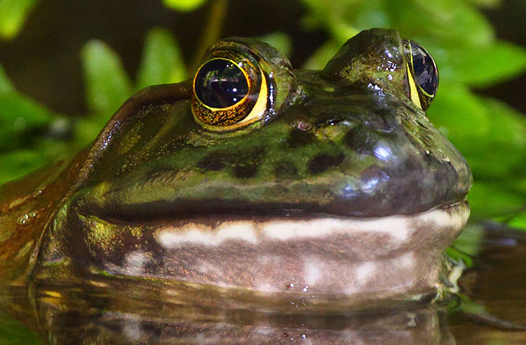
What is Dissecting the animal kingdom?
Journey through the Animal Kingdom from the simplest organisms to the most complex starting with invertebrates and ending with mammals
Learn about the different structures and their functions in the digestive, excretory, respiratory and circulatory systems of multiple organisms.
Investigate the following animal kingdoms: Invertebrate, Chordata (fish), Amphibia, Mammalia
Students dissect everything from an earthworm to a sheep eye!
Requires a LOT of memorization of structures and has frequent assessments

Slide 7
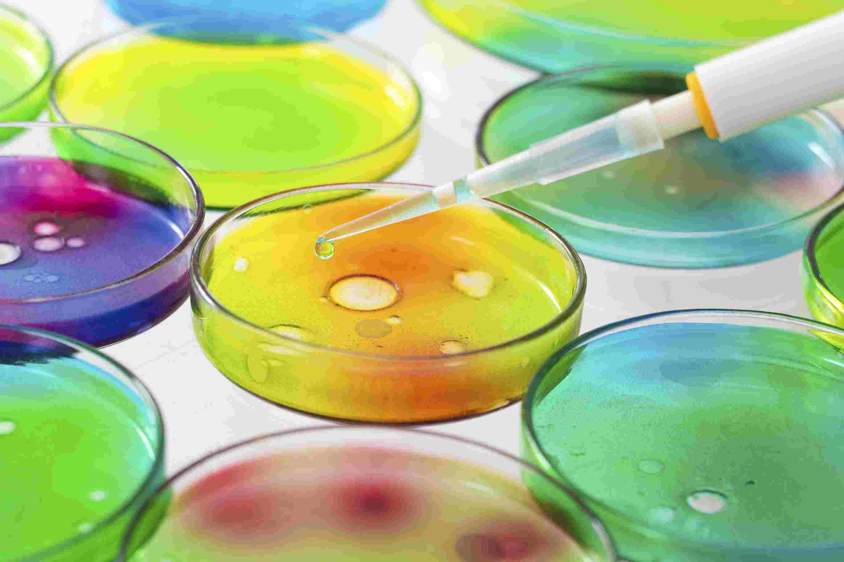
What Is microbiology?
Study of organisms too small to be seen by the naked eye.
Learn about
The history of microbiology
Structure of bacteria
How to control bacterial growth
Proper lab techniques and how to maintain aseptic technique
How to create ideal living conditions for bacteria
Antibiotics, Disinfectants and Antiseptics
Bacteria & Disease
Great course for anyone interested in the medical field

Slide 8
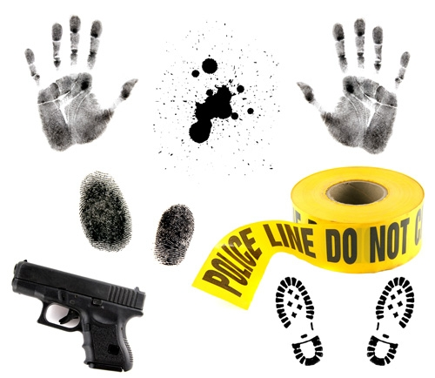
What is forensic science?
Study and application of science to the legal system
Incorporates problem solving and critical thinking skills to practice forensic science techniques and analysis of physical evidence
Investigation and lab-based course which promotes teamwork and collaboration among students
Examples of Evidence to be Analyzed:
Fingerprints
Hair &Fibers
Soil & glass
Blood & Human Remains
Impressions—tools, tires, shoes, dental, lip
Handwriting Analysis/ Counterfeiting

Slide 9
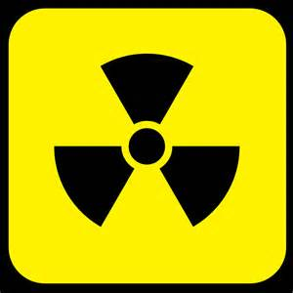
What is Nuclear Chemistry
This course is designed for all students interested in learning more about energy and nuclear power.
In this course we study:
Energy basics
Nuclear radiation
Nuclear power
Nuclear waste
Nuclear weapons
Nuclear disasters.
*Must complete Chemistry first

Slide 10
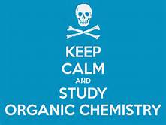
What is Organic Chemistry?
This course is a lab based course that studies carbon compounds.
This course is designed to expose students into the basics of organic molecules and reactions.
This course is designed for students that enjoy being in the lab and are going into any science or medical field, but all students are welcome.
*Must complete Chemistry first

Slide 11
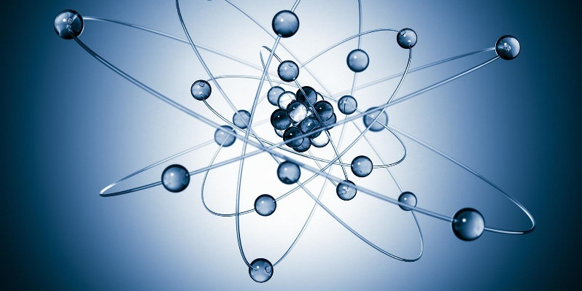
What is physics?
*Must complete Chemistry first
The purpose of Physics is to give the students a better understanding of the world around them as well as prepare them for college courses in math and the sciences.
Major topics include: Vectors, Kinematics (1 and 2 dimensional), Newton's Laws of Motion, Projectile or Circular Motion, Vibrations, Waves, Sound, Light, Work, Energy, Impulse, and Momentum.
While studying physics, the students will be afforded the opportunity of practicing the skills and processes of science as well as evaluating the impact of physics on society. The first year course is a trigonometry based physics course. The first year physics course is designed with the student already understanding and being able to use all trigonometry concepts involving sine, cosine and tangent functions as well as a knowledge of Chemistry which can be concurrently if taking the Advanced Chemistry course as a junior as well as the physics course.

Slide 12
AP Courses available AT SOLANCO
BIOLOGY
CHEMISTRY
PHYSICS
**SEE ME WITH QUESTIONS IF YOU ARE INTERESTED**

