Slide 1
Solanco’s Student assistance Program

Slide 2
The Student Assistance Program is
Designed to assist students to manage life’s challenges so they can reach their full potential
A process, not a quick fix

Slide 3
The Student Assistance Program Does Not:
Diagnose or Provide Treatment
Replace other School-Based Programs
Replace a Parents’ Decision-Making Responsibilities Regarding Their Child’s Education

Slide 4
With your permission, as a SAP team, it is our job to help eliminate barriers to learning.

Slide 5
4 Steps
to the
SAP Process

Slide 6
REFERRAL
Anyone can refer a student to SAP when they are concerned about someone’s behavior: any school staff, a student’s friend, a family member or community member. Students themselves can even go directly to the SAP team to ask for help. The SAP team contacts the parent for permission to proceed with the SAP process.

Slide 7
Many issues can negatively impact students’ learning including those related to:
Family Conflicts
Emotional or Mental Health problems
Substance Abuse (theirs or someone else’s)
Bullying or other Peer Conflicts

Slide 8
Some of the concerns SAP can help students with are:
Anxiety
School Issues
Conflicts with Peers
Dating and Relationship Issues
Depression or Suicidal Thoughts
Family Concerns
Alcohol and/or other Drug Problems
Anger Issues

Slide 9
TEAM PLANNING
The SAP team gathers objective information about the student’s performance in school from all school personnel who have contact with the student. Information is also collected from the parent. The team meets to discuss the data collected and also meets with the student. Together, a plan is developed that includes strategies for removing the learning barriers and promoting the student’s academic and personal success to include in-school and/or community-based services and activities.

Slide 10
INTERVENTION AND RECOMMENDATIONS
The plan is put into action. The team assists in linking the student to in-school and/or community-based services and activities. The team might recommend a drug and alcohol or mental health assessment.

Slide 11
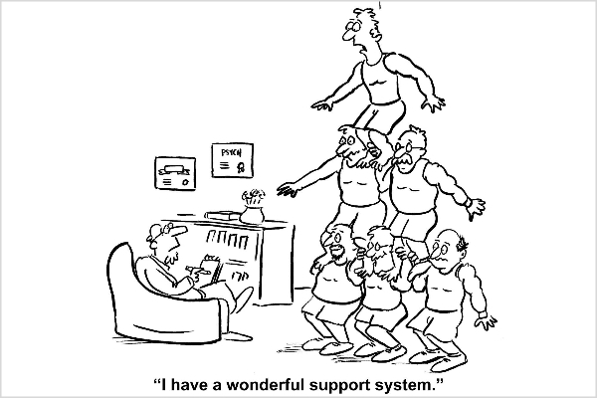
SUPPORT AND FOLLOW UP
The SAP team continues to work with and support the student and their family. Follow-up includes monitoring, mentoring, and motivating for academic success.

Slide 12
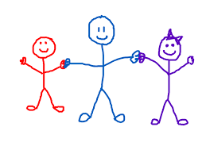
SAP is here to help you with the concerns of life by helping you find solutions you may need to be successful.

Slide 13
SAP TEAM MEMBERS
Mr. Long
Mr. Esche
Mrs. Capoferri
Mrs. McTaggart
Mrs. Shumaker
Mrs. Dawley
Mr. Rourke
Mrs. Spearing
Mrs. Mathis
Mr. McTaggart
Mrs. Graybeal
Mrs. Taylor
Mrs. Smith (SAP Coordinator)
Mrs. McRobbie
Mrs. Cox
Mrs. Prokay
Mrs. Leininger

