Slide 1
Rising Sophomores- Course Selection and Future Planning
2020

Slide 2
Objectives for Today
Discuss career exploration, update Smart Futures with Career Plan
Revisit and edit 4-Year Plans in Google docs, upload to Smart Futures
Review Educational Planning Guide and its importance
Review courses available for selection for rising sophomores
Prepare to begin the Course Selection Process in PowerSchool NEXT WEEK
Jones Science classes- 2/4
Gordon and Armstrong Science classes- 2/5
Miller Science classes and those without a science- 2/6

Slide 3
Resources/Materials Available
School Counselor
Teachers, by department and by course
Educational Planning Guide
4-Year Plans
Smart Futures
Guidance webpage- solancoguidance.weebly.com

Slide 4
Opening Activity- Fact or Fiction??
Fact or Fiction?
1. Going to college is a good future plan.
2. Career Planning starts in 11th grade.
3. CTC is a place for students who do not want to go to college.
4. There are two options senior year- CTC or classes here.
5. People who go to college make more money than those who do not.
6. Asking my teachers for course suggestions can be helpful.

Slide 5
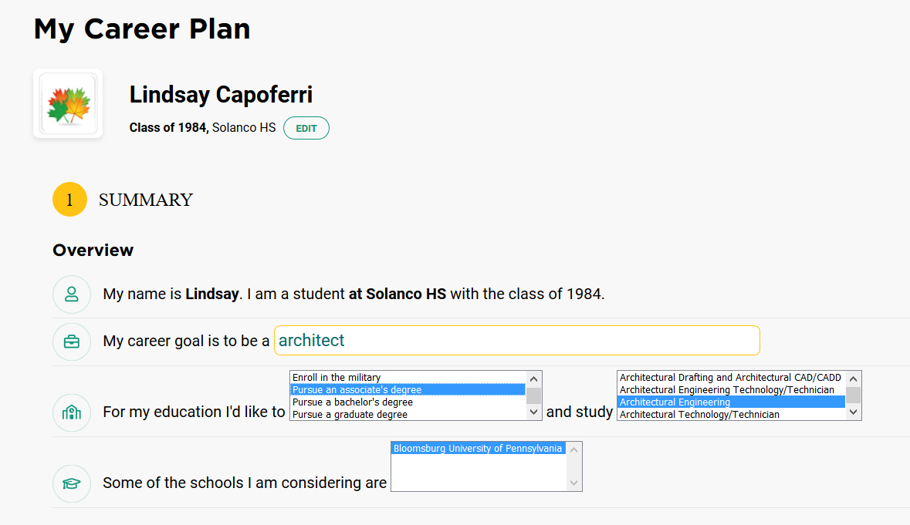
What are your Career Plans so far?
Show me on your hands how certain you are about your career choice and future planning right now.
0- I have no stinking clue.
1- I have a tiny idea what I want to do.
2- I have more than one idea.
3- I am pretty sure of the career I want to do but not sure how to get there.
4- I am almost positive of my career and how to get there.
5- I am 100 percent sure of what I want to do and how to get there.
Later on, I will ask that you update your Career Plan in Smart Futures as it stands now. This allows anyone working with you to know what you are planning.

Slide 6
The Purpose of Educational Planning
Career-Driven
Choices!
Thinking Ahead
Long-term Success
Educational Planning Guide on the Guidance website: https://solancoguidance.weebly.com/important-links.html

Slide 7
Graduation Requirements
If you fail core classes, or more than 2 credits, you will definitely need to recover credits to graduate on time.
4 English
3 Math
3 Science
3 History
1 Extra Core
1.5 PE Credits
.5 Health
10 Electives
26 Total Credits

Slide 8
Grade Level
Grade level is determined by the amount of credits a student starts the year with according to the following chart:
Grade 10: 5 Credits
Grade 11: 12 Credits
Grade 12: 19+ Credits
Students are scheduled for 7 Credits each year usually including 1 English, 1 Math, 1 Science, 1 History, and a combination of PE and Elective Credits.

Slide 9
Courses Available to Sophomores
English: Adv World Lit, World Lit
Social Studies: Western Civilization, AP European History
Math: Algebra II, Adv Geometry, Geometry, Integrated Algebra II, AP Statistics, AP Computer Science
Science: Biology, Adv Chemistry
Fitness: Fitness Elective Choices:
Exercise and Fitness for Life
Fitness Activities I and II
Strength and Conditioning
Performance Training
Electives by Departments (review with Course Selection Sheet)

Slide 10
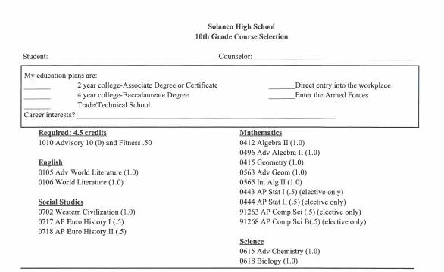
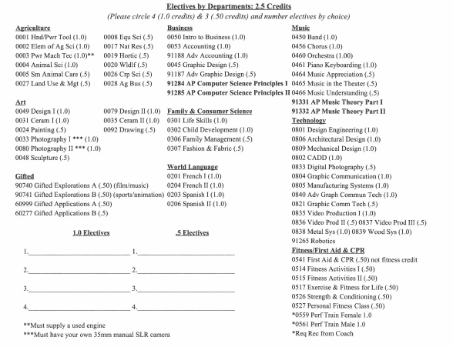

Slide 11
Course Selection
Core Classes: English, Math, Science, and History
Your CORE courses will mainly be chosen based on progression from one class to another. For example, all 1st year students complete English I. All 2nd year students complete World Lit.
You should be talking with your core teachers about Advanced or AP courses.
If you are a student with an Individualized Education Plan, your courses will be determined on a team basis.
You should spend the next few days talking with parents and teachers about courses so that you can select your courses next week. Then, any further conversation would allow you to make changes as needed.
NEXT WEEK: Students will log into PowerSchool and make their course selection until the end of February.
PowerSchool will be open for students to make changes for approximately TWO WEEKS to review course selections and reach out to counselor with questions.

Slide 12
Some things to remember when making selections…
*Take advice from your teachers for selections, especially with core courses
*Consider Career interests in selecting your courses
*If you are considering a cluster program at CTC for your junior year, take two Fitness courses
*Pay attention to courses with prerequisites
*You may not get your first choices, so pick good alternates!

Slide 13
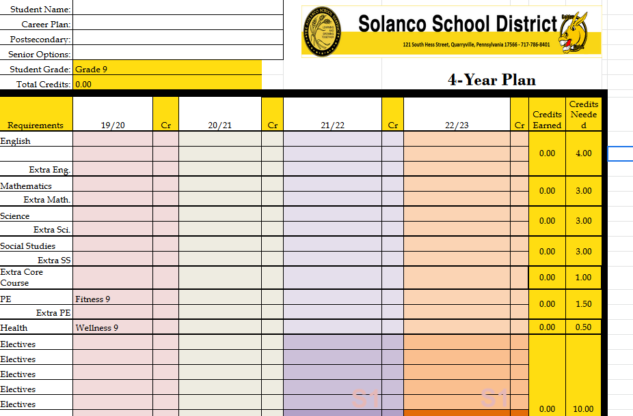
4-Year Plan
What is the purpose of a 4-Year Plan?
Let’s revisit the 4-year plan that you started last year in middle school. If you did not create one, you will have the opportunity.

Slide 14
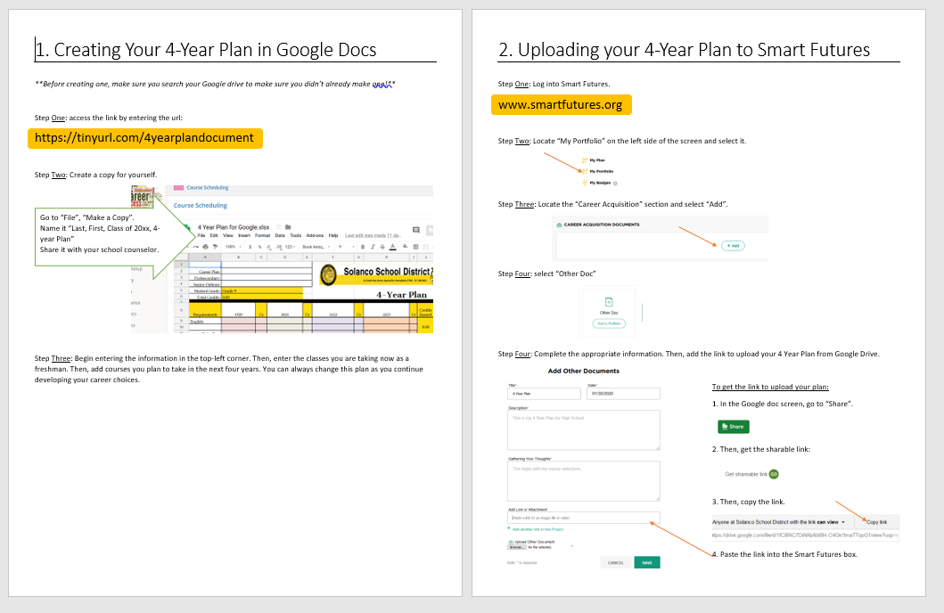

Slide 15
For the Remainder of Today:
Locate your 4 Year Plan, and log into Smart Futures.
Update your 4 Year Plan (or create it as needed) and link it to Smart Futures.
Using the Educational Planning Guide online, your career goals, your 4 Year Plan, and the Course Selection Sheet, begin planning what courses you’d like to select for next year and the following two years.
Come to class next week prepared to make your initial selections. Schedule an appointment with your school counselor as needed for continued discussion. Final course selections will be due at the end of the month!

Slide 16
Good Morning
Please:
Get out your Course Selection Sheet from our lesson last week.
Log into Smart Futures. Log into PowerSchool. If needed (not linked in Smart Futures), search for 4-Year plan

Slide 17
Rising Sophomores- Course Selection and Future Planning
Part Two- Welcome Back!!!

Slide 18
Today’s Objectives
Together: Review 4-Year Plans
Do Individually: Connect 4-Year Plan to Smart Future if needed
Together: Review Courses for Sophomores
Do Individually: Choose courses and alternatives
Together: Review the Course Selection Process
Do Individually: Select your courses in PowerSchool
Together: Wrap up and Answer questions
Do Individually: Complete exit survey
**With remaining time, work on Smart Futures or continue adding to 4-Year Plan**

Slide 19
What questions do you have?
Think of two questions about..
Courses for next year
Future options
Your 4-year plan
Course selection in general
Turn and ask the questions to someone close by.
What are you still wondering?

Slide 20
4-Year Plan
Did you get to link your plan to your Smart Futures account?
Some important notes about your plan:
Each column should add up to 7 credits.
You should have 9th and 10th graders completed, and you should have junior and senior year at least started.

Slide 21
Courses Available to Sophomores
English: Adv World Lit, World Lit
Social Studies: Western Civilization, AP European History
Math: Algebra II, Adv Geometry, Geometry, Integrated Algebra II, AP Statistics, AP Computer Science
Science: Biology, Adv Chemistry
Fitness: Fitness Elective Choices:
Exercise and Fitness for Life
Fitness Activities I and II
Strength and Conditioning
Performance Training
Electives by Departments (review with Course Selection Sheet)

Slide 23
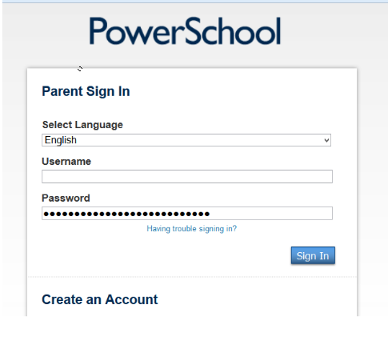
Step 1
Login to PowerSchool.
https://powerschool.solanco.k12.pa.us/public/

Slide 24
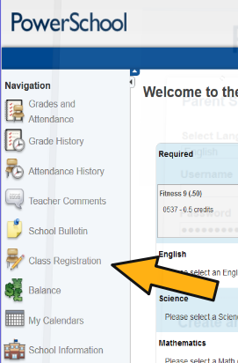
Step 2: Find the Button for Class Registration
It may look like this:

Slide 25
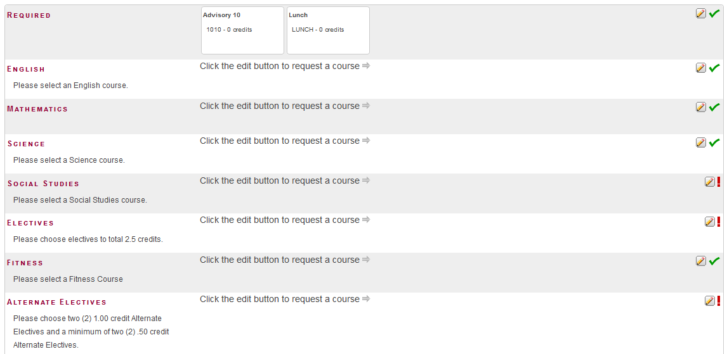
These numbers must match before this process is complete.

Slide 26
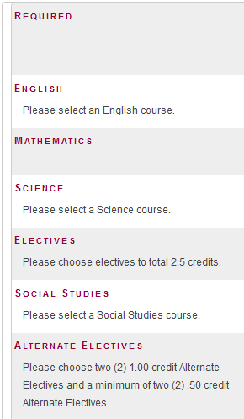
Step 3 – Review and Select Core Courses
Check all the green check boxes to be sure you are chosen for appropriate levels. If you disagree with your choice, talk to your teacher!

Slide 27
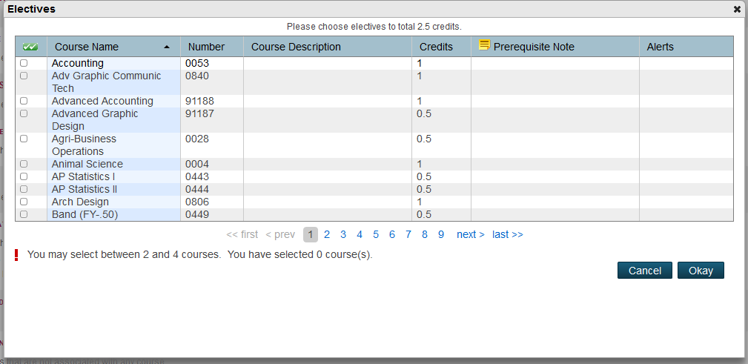
Step 4 – Choose your Top Elective Choices
You may not select more than 2.5 total credits.
These are loaded in alphabetic order. You must leaf page by page to find the one you want.

Slide 28
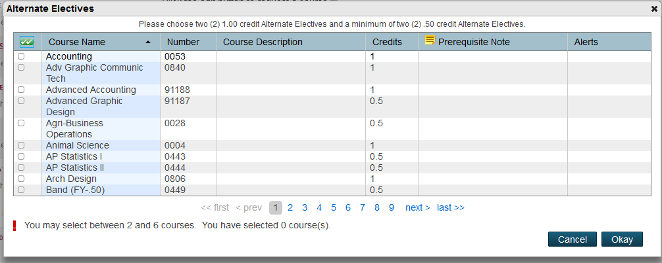
Step 5 – Choose Your Alternates.
Please choose two 1 Credit alternates and two .5 Credit Alternates.
PowerSchool will try its best to select your top choice based on all possible course combinations.
In the event that a course is not available during a time slot, it will use the Alternates to build your schedule. Please select meaningful alternates that you could live with in the event a top choice class is not available.

Slide 29
Please Raise Your Hand if you are stuck!
You cannot close this out unless you select the correct amount of credits for electives and alternates.
Access will be closed by the end of February.
Please follow up with your counselor if you think of any other questions.
Finish strong this year so that you can continue next year being awesome!
A Few Reminders:
This PowerPoint and other information is available on our website:
www.solancoguidance.weebly.com

Slide 30
Work on Completing:
You cannot close this out unless you select the correct amount of credits for electives and alternates.
Access will be closed by the end of February.
Please follow up with your counselor if you think of any other questions.
Finish strong this year so that you can continue next year being awesome!
Individually:
This PowerPoint and other information is available on our website:
www.solancoguidance.weebly.com

Slide 31
Post-Survey
Please provide us with some feedback:
https://tinyurl.com/CourseSelectionPost

Slide 32
Side Note… Course Change Requests
Our goal is for you to have your schedule in your hand before summer break.
You will have a window over the summer to make request changes to your counselor.
Course change requests after this period will require parent approval, and will result in a DROP being recorded on the transcript.
A recorded DROP will reflect very poorly on a transcript, GPA, and Rank. In many ways, it’s better to attempt a course and receive a D than it is to drop.
Ideally, your teacher will have had a conversation with you especially if they recommended you for Advanced or AP Classes. If they recommend you for that, you will be scheduled for it.

