Slide 1
2019/2020 PSAT/ Junior Information Night
Your High School Counseling Team:
Patti McTaggart: A-G
Kelly Shumaker: H-P
Lindsay Capoferri Q-Z
Lindsay Capoferri: Sc-Z

Slide 2
Agenda
PSAT Test Scores
Online Vs. Paper report
Kahn Academy
Timeline for Juniors
Opportunities Scholarship
Dual Enrollment
Question and Answer Time

Slide 3
What are the Benefits of Taking the PSAT/NMSQT®?
Prepare for the new SAT®,
Get free, personalized, and focused practice through Khan Academy®
Start getting ready for college with college and career planning tools
Enter the National Merit® Scholarship Program
See which AP® courses you might be ready for
Get admission and financial aid information from colleges

Slide 4
How Do I Access My PSAT/NMSQT® Scores and Reports?
Review Your Paper Score Report- They are not in yet. We will get them to students with their original test booklets.
Review your Online reports- this is the preferred method because it familiarizes you with the College Board
4

Slide 5
When can I see my scores?

Slide 6
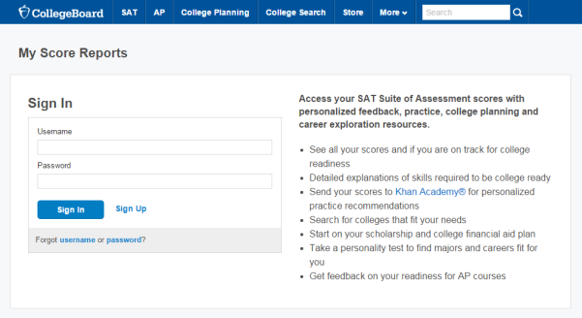
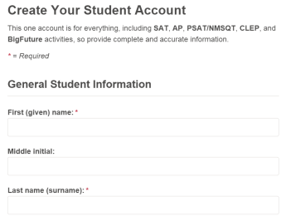
How Do I Access My Online PSAT/NMSQT® Scores and Reports?
Log in to an existing College Board account or create a new one at studentscores.collegeboard.org
https://studentscores.collegeboard.org/viewscore
6

Slide 7
What Are My Next Steps?
Continue to take challenging courses in high school
Career exploration ( links on our website)
Start building a college list
Link scores with Khan Academy
Set up a practice plan and stick to it
Register for the SAT
Utilize other resources to research and prepare for college
7

Slide 8
Official SAT Practice with Khan Academy® – It’s FREE!
Sign up for Official SAT Practice for free
satpractice.org
Complete practice problems and diagnostic quizzes
Link your College Board and Khan Academy accounts.
All SAT Suite results will be sent to further customize practice on Khan Academy using actual results.
8

Slide 9
What steps will I follow to link my College Board account to Khan Academy®?
Step 1: Log in or create a Khan Academy Account
Step 2: When prompted; agree to link your Khan Academy and College Board account. You will then be directed to collegeboard.org.
Step 3: Sign in or create a College Board Account
Step 4: When prompted; hit “Send” to authorize the account linking
Step 5: Start practicing on Official SAT practice on Khan Academy!
9

Slide 10
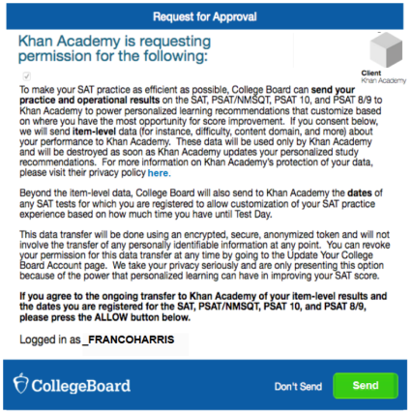
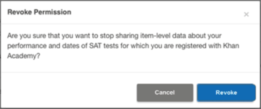
How can I Link my College Board and Khan Academy® Accounts?
After successfully logging in to your College Board account, you will be asked to authorize the account linking.
After clicking “Send,” you will be redirected to SAT practice on the Khan Academy site.
You can remove the link at any time, by clicking on “Revoke” which is found in College Board account settings.
10

Slide 11
How Can I Practice with Khan Academy®?
https://www.youtube.com/watch?v=patbkNnnAQ4

Slide 12
When Should I Take the SAT®?
Most students take the SAT in the spring of their junior year.
Many students choose to take the SAT more than one time. Additional SAT dates include:
May 2nd
August 29th ( anticipated)
October 3rd ( anticipated)
12

Slide 13
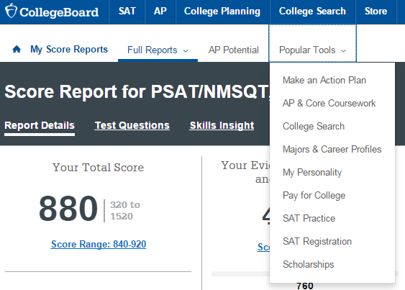
How Do I Register for the SAT®?
SAT Registration link from Popular Tools menu or
www.sat.org/register
13

Slide 14
College Board Opportunity Scholarships

Slide 15
Opportunity Scholarships

Slide 16
6 Steps…

Slide 17
To do list….

Slide 19
Where to start?

Slide 20
Everyone is eligible…

Slide 21
Opportunities scholarship
https://www.youtube.com/watch?v=2CPku32bj5I&feature=youtu.be

Slide 22
Fall of Junior Year

Slide 23
Winter…

Slide 24
Spring of Junior year….

Slide 25
Summer before Senior year..

Slide 26
What is Dual Enrollment?
Students are enrolled in both High School and College
Most college courses are 3.0 credits. Students earn 1.0 credit for high school. For example, if a student takes English Comp at HACC, they receive 3.0 HACC credits ( at HACC) and 1.0 English credits at the high school.
Students have the option to take courses on campus or virtually
Core courses are weighted like AP classes.
Course are discounted for High School students.
Steven’s Tech- Early enrollment ( different then other programs)

Slide 27
Dual Enrollment Contract

Slide 28
Dual Enrollment Opportunities
HACC- Chala Thomas
CMTHOMAS@hacc.edu
Stevens Tech- Megan Dancause:
dancause@stevenscollege.edu
PA College of Health and Science: Jordan Eichelman
jjeichelman@pacollege.edu
Millersville University: Katy Ferrier
katy.ferrier@millersville.edu
Cecil College: Mike Jerome
mjerome@cecil.edu
West Virginia University
Kelly Lowery
kelly.lowery@mail.wvu.edu

Slide 29
Open Forum:
A-G: Mrs. McTaggart; patricia_mctaggart@solancosd.org
H-P Mrs. Shumaker; kelly_shumaker@solancosd.org
Q-Z: Mrs. Capoferri; lindsay_capoferri@solancosd.org
Important Dates:
Financial Aid Night: October/November during Senior Year.
Fall College Visits:
Familiarize yourself with what colleges come to the high school now, and be prepared for next year when they will return to talk to you.
College Applications:
Use the summer to go on tours and visits to colleges so you can start applying by the end of October.
Reminder:
Check out the Junior Timeline from the College Board for a good understanding of where your student should be!
Don’t forget about REMIND 101. Pick up your instruction sheet before you leave!
Junior Athletes should be sure to register to the NCAA by the end of their Junior Year.
Office: (717) 786-2151
Fax: (717) 786-1808

Slide 30
Take a Guidance Tour
http://solancoguidance.weebly.com/

