Slide 1
Course Selection
Senior year….

Slide 2
Graduation requirements
26 credits
4.0 English
3.0 Science
3.0 Math
3.0 Social Studies
1.0 additional core. This means you have to pick another Math, Science or Social Studies and take 1.0 additional credit.
1.5 Fitness
.5 Wellness
5 Credits to be considered a Sophomore
12 Credits to be considered a Junior
19 credits to be a Senior
You MUST have 19 credits to be eligible for CTC
If you DO NOT have 19 Credits going in to Senior year you will have to take credit recovery/summer school

Slide 3
Review Graduation Progress
Make sure you:
Are currently passing all of your classes
If you failed anything….see your counselor
American Studies
Fitness
Graduation Progress sheet
End of this year you SHOULD have completed
3 Years of English
3 Years of Math
3 Years Science
3 Years of Social Studies
1.5 fitness
.5 wellness
If you are missing anything, now is the time to speak with your counselor

Slide 4
CTC senior year
Most programs are full day
7 credits
1.0 English
1.0 Math
5.0 Electives
You MUST have all requirements met before senior year if you want to attend CTC.
You MUST have all your requirements to be eligible for senior options.

Slide 5
Today you will….
Review Graduation Progress
Review credits
Enter course requests
Register for CTC program, CTC English and CTC Math
What you register for is not necessarily the program you are accepted in…
Online Survey
https://tinyurl.com/CourseSelectionPost

Slide 6
Senior Options
Dual Enrollment–
HACC, Stevens Tech, Cecil College, Lancaster Bible College, PA College of Health Sciences, Franklin and Marshall, and Millersville University
Work Study – Must have all of your credits. No credit is awarded.
Independent Study – advanced level work, beyond courses you have completed within a particular department. Graded as P/F for credit.
Internships – First and/or second semester. These may occupy one or two periods. Graded as P/F for credit.
CTC – There are still programs that may have openings. See updated list and complete an application ASAP.
All options are arranged by the student. Please complete the proper paperwork as soon as possible.

Slide 7
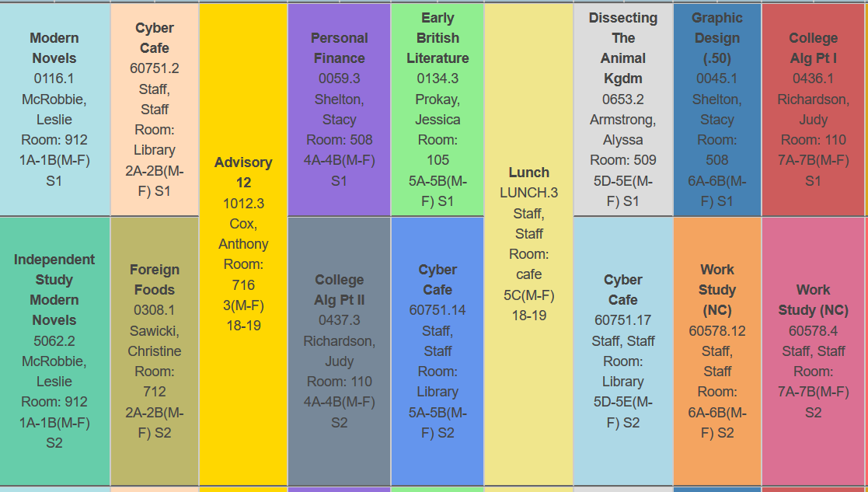

Slide 8
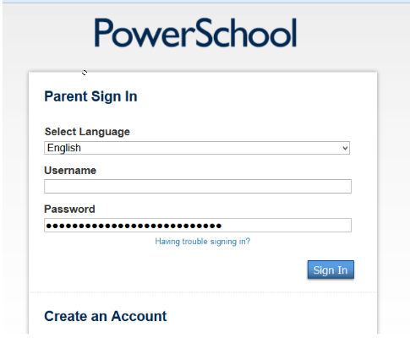
Step 1
Login to PowerSchool.
https://powerschool.solanco.k12.pa.us/public/

Slide 9
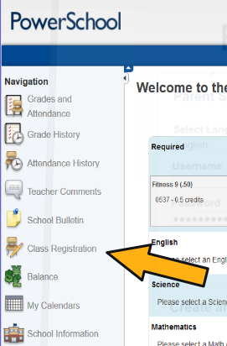
Step 2: Find the Button for Class Registration
It may look like this:

Slide 10
Step 2: Find the Button for Class Registration
It may look like this:

Slide 11
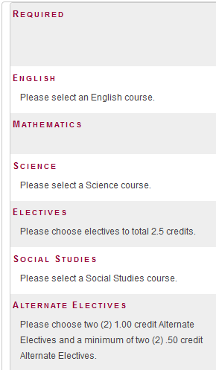
Step 3 – first, choose core classes
Reminder of GRAD Requirements:
4 credits of English
3 credits of Math
3 credits of Science
3 credits of Social Studies
1 additional Core Credit
1.5 fitness
.50 wellness
Most seniors still need 1.0 credit of English.
Students pursuing post-secondary education are encouraged to take a 4th year of math and additional core electives.

Slide 12
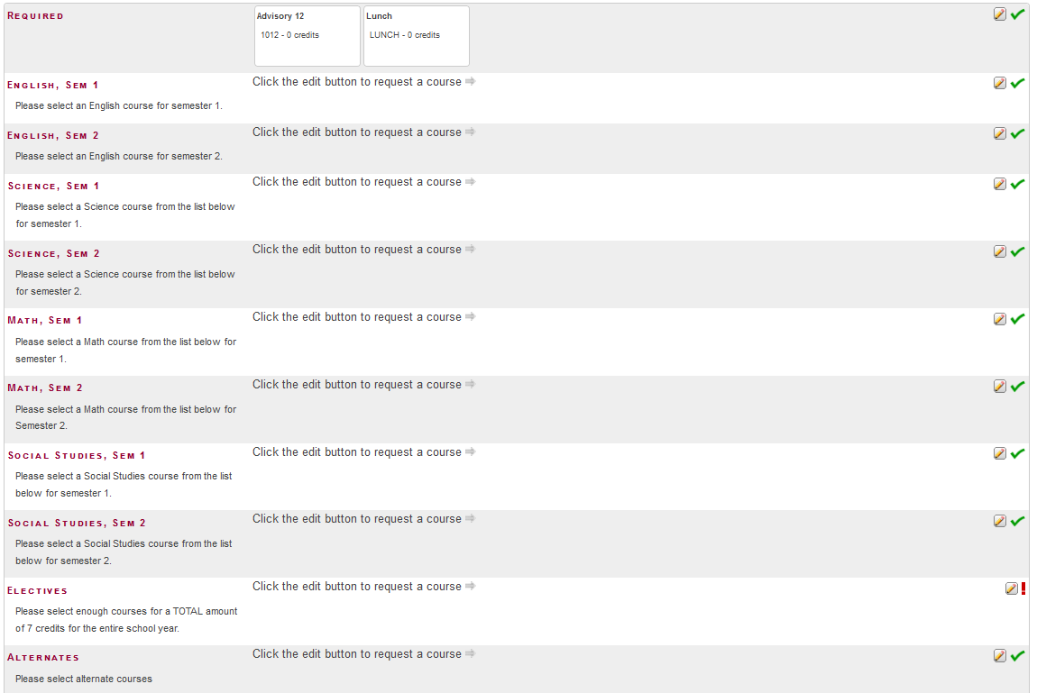

Slide 13
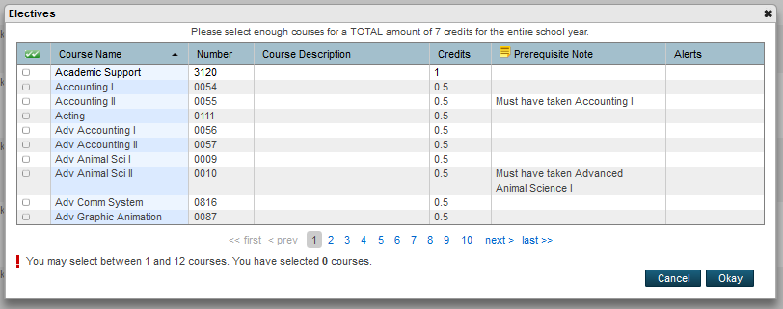
Step 4 – Choose your Top Elective Choices
Be sure to select electives for a total of 7.0 credits. These are your top choices.
These are loaded in alphabetic order. You must scroll page by page to find the one you want.

Slide 14
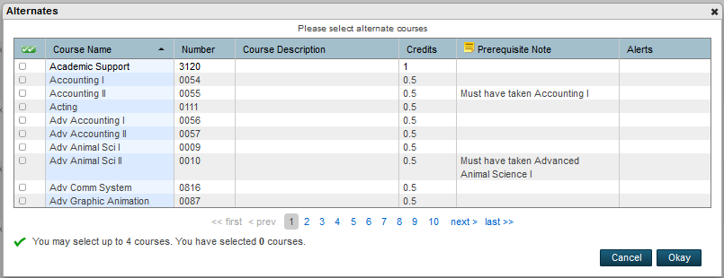
Step 5 – Choose Your Alternates.
You are strongly encouraged to choose alternate classes.
PowerSchool will try its best to select your top choice based on all possible course combinations.
In the event that a course is not available during a time slot, it will use the Alternates to build your schedule. Please select meaningful alternates that you could live with in the event a top choice class is not available.

Slide 15
Please Raise Your Hand if you are stuck!
You cannot close this out unless you select the correct amount of credits for electives and alternates.
Access will be closed in about two weeks. This gives you and your parent/guardian the opportunity to log in and make changes only to electives.
If you plan to attend the CTC, be sure that you will have completed all of your fitness credits.
Please follow up with your counselor if you think of any other questions.
Finish strong this year so that you can continue next year being awesome!
A Few Reminders:
This PowerPoint and other information is available on our website:
www.solancoguidance.weebly.com

