Slide 1
Calling All College-Bound Seniors!
A-G: Mrs. McTaggart
H-P: Mrs. Shumaker
Q-Z: Mrs. Capoferri
Career Room: Mrs. Phillips
College/Career Advisor: Ms. Schick
Guidance Secretary: Rhonda Beane
Come on in, and grab a seat!
There are materials in the back for your reference.
P

Slide 2
What’s your experience level?
If you had a student who already went through the college application process………….
If you are new to the college application process….

Slide 3
Today’s Topics
SAT vs ACT
The Application Process
Transcript Requests
Online or in Guidance- Orange papers
Letters of Recommendation
The Common Application/Applying
Scholarships/Financial Aid
Information from Ms. Schick
Question and Answer Time

Slide 4
College Entrance Exams
SAT with Writing
ACT
The SAT tests knowledge of critical reading, writing that includes a short essay and MC questions, and math that includes algebra, geometry, statistics, and probability.
The “optional” essay should be taken at least one time.
It is generally widely accepted by most colleges in the US and PA.
*Deadline for October- 9/6*
The ACT tests the same areas as the SAT, but it also assesses Science.
The Writing portion is optional, but encouraged, especially if colleges specifically ask for it.
The ACT is scored based on the number of correct answers. It does not count incorrect responses with no penalization for guessing.
Also includes an Interest Inventory that shows where professionals who scored similar to your scores work.
Register Here!!!
www.collegeboard.org
www.actstudent.org

Slide 5
Tips for Acing the College Entrance Exams
Most studies agree there is no tried and true method for studying for these exams.
However, there are things you can do to help prepare for them.
Take challenging courses in high school.
Read every day (and not just blogs and Facebook).
Practice for the SAT with free online material: collegeboard.org
Purchase a College Board approved study guide and practice.
Most people take the appropriate exam at least twice.
Some studies suggest that taking the test three or more times does not necessarily show increased scores.
Keep in mind the SAT/ACT are one piece of your application that is used to illustrate who you are as an applicant.

Slide 6
SAT Subject Tests
These are specifically requested by more competitive colleges.
Be careful to sign up for the correct test.
$28.00 and a long call to the College Board.

Slide 7
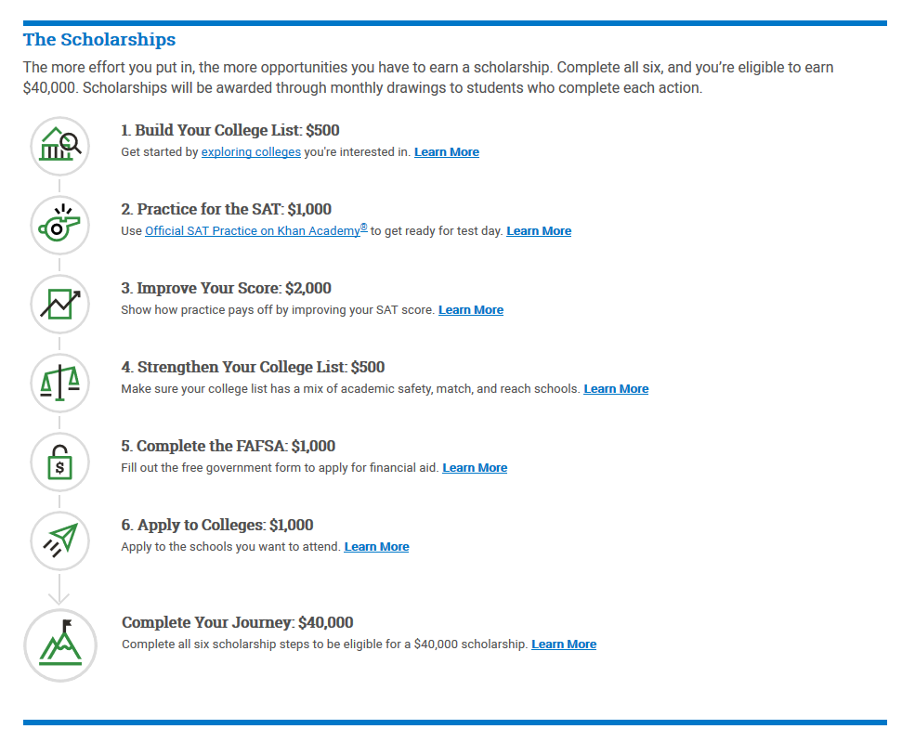
College Board Opportunity Scholarships
College Board has a new scholarship program to guide students through the college planning process.
Visit:
cb.org/opportunity
For more information!
This is a great way to have guidance through the process while also becoming eligible for scholarship.

Slide 8
The Application Process
Your counselor wants you to be sure you understand your requirements for admission to each school you apply.
Part of going to college means taking responsibility and owning your situation (Understand individual admission processes like Early Decision, Early Action, and Rolling Admissions).
Use your counselor as a resource or research tool.
You own the application process.
Understand your college’s requirements.
Know your GPA and Rank.
Know when specific parts of applications are due (not every college will share the same due date).
Tip of the Day: We recommend you apply to three to five schools including a dream school and a safety school.
We do not weight GPA, but we do weight rank. Please realize the difference.

Slide 9
Transcript Requests
Official transcripts are ONLY sent directly to colleges/universities/coaches.
They can take up to five school days to process. Please get requests in as early as possible.
Occasionally a student requests a transcript to take to a college visit, transcripts handed to students are ALWAYS Unofficial.
To request a transcript, please complete an application checklist in Guidance or on our website.
Very important in online applications because your counselor is not always notified.
Notes:
Very important

Slide 10
Words of Advice…
Colleges want to see independent and responsible students.
Keep in mind your counselor is working with every other senior on his or her caseload. Do NOT wait until the last minute to communicate that you need letters or application materials.
Students should start thinking about a junior or senior teacher who knows them well enough to provide a letter of recommendation.
Stick to the core subject area teachers.
Brag Sheets are helpful to teachers/counselors.
Notes:
LOR:
Does your school want them?
If you need three, best practice is to ask for five teachers.
Give teachers and counselors plenty of notice and a BRAG SHEET – located in Guidance. (if you need one, please raise your hand).

Slide 11
Common Application
More than 700 Colleges/Universities use Common Application.
Been around for 30 years.
Nearly 1 million students use the Common Application each year to submit over 3.5 million applications via the Common App Online.
Efficient & Effective.
<www.commonapp.org>

Slide 12
Finally…
It’s time to start your application to a school!
Being prepared will help alleviate all the anxiety surrounding the application.
This is a chance to illustrate and demonstrate who you are as an individual.
Be specific, use examples, and be honest.
Talk about your accomplishments, but do not embellish things you have done.
Know what type of application is preferred.
Integrity means everything!
Notes:
GPA and Rank discussion during integrity bullet.

Slide 13
Tips for Common Application
Know your deadlines!!!
Application deadline mainly for student.
Save your work often.
Logout after each session.
Know your Counselor’s Name!
Make sure you tell teachers who will need to upload a letter of rec!
Use a word processor to type your writing samples before cutting and pasting or uploading them into the online forms.
Notes:
Colleges cannot review what I or your recommenders submitted until the student has completed his/her application.

Slide 14
Scholarship Information
This is different from Financial Aid which we will discuss later in the year.
Types:
Institutional- From the college/university
National and Regional – Information in the Career Center, fastweb.com, myscholly.com, schoolsoup, https://www.tfec.org/county/lancaster/
Local – Not available until the Spring.
Come out in March and are due about a month later.
Tips
Follow Ms. Schick’s social media pages.
Visit The Career Center or Guidance Webpage for “Show Me the Money” updates from Mrs. Phillips.
Be careful of scams and paid Scholarship services like “Who’s Who”
Resources are available, but the student is responsible for searching and reviewing what is available.

Slide 15
The Reality
By the end of the fall, you should have completed the following tasks:
Complete the SAT at least 1 time.
Visit through private tours or open houses at least one college, but ideally, all colleges you are considering.
www.campustours.com – Virtual Campus Tours
Complete applications with all requirements.
Check the scholarship newsletter often.
Pay attention to ANNOUNCEMENTS, SOCIAL MEDIA POSTS, etc. The information will not fall into your lap.
Attend Financial Aid nights. Dates are at the end of the PowerPoint.
Complete the FASFA after October 1st . Know your school’s completion due date.
Continue to monitor your GPA.

Slide 16
N.C.A.A. Information for Potential College Athletes
Waiver- get online or in Guidance
We cannot communicate with coaches without the waiver in our office.
Registered on the Eligibility Center portal through NCAA website
Students need to be sure that they understand how NCAA Academic Eligibility is determined.

Slide 17
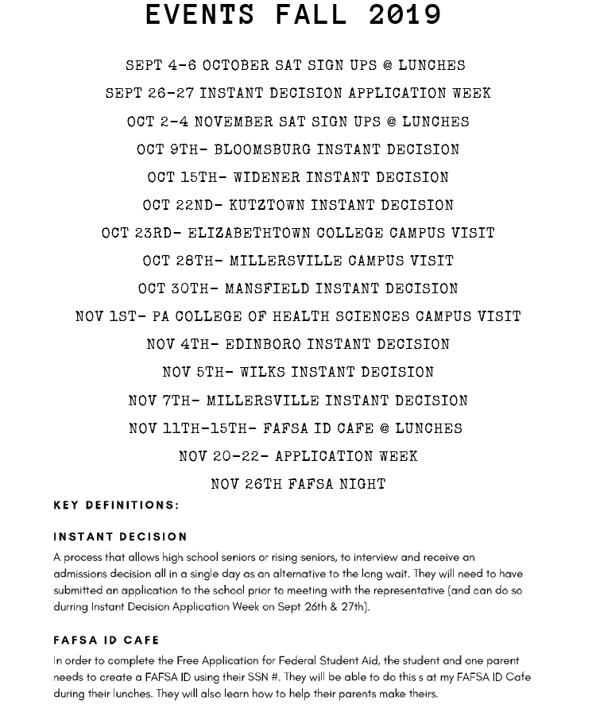
College and Career Info from Ms. Schick

Slide 18
Open Forum:
Important Dates:
9/6: October SAT Sign-Up Deadline
11/11-15: FAFSA ID Café at lunches with Ms. Schick
11/26: FAFSA Night with PHEAA
A-G: Mrs. McTaggart; patricia_mctaggart@solancosd.org
H-P: Mrs. Shumaker; kelly_shumaker@solancosd.org
Q-Z: Mrs. Capoferri; lindsay_capoferri@solancosd.org
College/Career Advisor:
Ms. Schick; katie_schick@solancosd.org
Don’t forget to utilize the Guidance website:
solancoguidance.weebly.com
Office: (717) 786-2151
Fax: (717) 786-1808

