Slide 1
9th grade guidance lesson
How can I be the most effective student I can be?

Slide 2
As you come in, find the table with the same symbol that is on your handout in the top right corner.

Slide 3
With the people sitting near you-
Consider the Essential Question for today:
How can I be the most effective student I can be?
Discuss how your symbol might relate to what we are exploring today.
Share out.

Slide 4
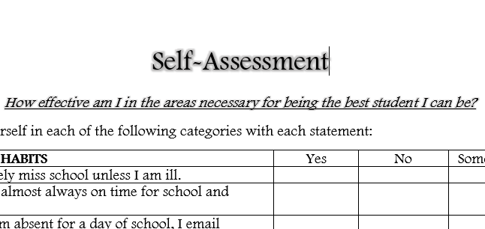
Self-Assessment
Take the next 5 minutes or so to rate yourself in each of the five categories.
These five categories represent 5 areas that influence how effective you are as a student.
When you have rated yourself in each category, use the instructions to total your points in each.

Slide 5
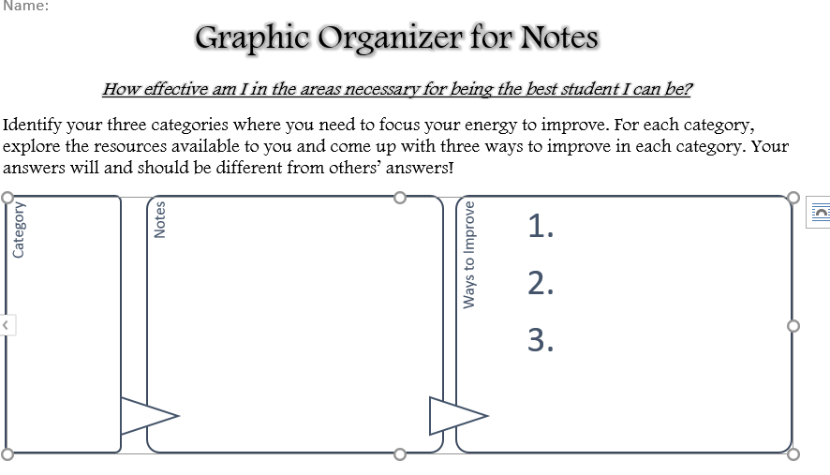
Where do you need to focus?
Identify the three categories with the highest number of points. These will be your focus areas today.
Write these down on a graphic organizer that you can find in the middle of the tables.

Slide 6
Explore!
Website for Effective Student Resources:
https://tinyurl.com/EffectiveSR
Using the links on this website, look for ways to improve your own habits in the categories you identified in your self-assessment.
Remember, your answers will be different from others’ answers.
Some videos are much longer than you have time for today, so look for important points and move on. You can always come back to the site another time.
For each of your three categories, you are looking for three SPECIFIC ways to improve.

Slide 7
Closing-
Please share with me at least three things you plan to do (from any categories) to become a more effective student.
https://tinyurl.com/ESClosing
Take the handouts with you so that you can use them for your own improvement.
Feel free to re-visit the website with resources so that you can continue to improve.

