Slide 1
Parent Information Meeting 9th grade course selection, 2019

Slide 2
Purpose of Tonight’s Meeting
Discuss the overall process of course selection, what courses are available for your child, and some general information about 9th grade.

Slide 3
The Timeline
8th Grade School Year - Now
8th graders have been using resources to explore careers related to their interests and strengths.
Recently, in the past few weeks-
8th graders have been learning about the opportunities at the high school. Using the Educational Planning Guide and Course Sheets, they started working on a 4-Year Plan.
Ongoing-
Students will continue career exploration and 4-Year Planning.
Today thru the end of February-
Spend time reviewing your child’s options. Meet with Mrs. Pearson or Mrs. DeSimone as needed. Help your child make decisions about the courses he/she is going to take. Ask questions!
Last Week of February-
The students will select their courses, BUT they MUST have their course selection sheets signed by a parent!
End of February-
Students will turn in drafts of their 4-Year Plans

Slide 4
Academic planning
It is important to plan for high school, not only 9th grade, but also for the remaining years.
The Educational Planning Guide is a useful tool for planning. It is never too early to start thinking about future options, even senior year.
Students have been working through Career Exploration to identify what careers align with their goals/personalities.
Each student is working on a 4-Year Plan, which is maintained in their Google Drive folders. Encourage them to share these with you!

Slide 5
4-Year plan

Slide 6
Credits
Students need 26 credits to graduate.
Most courses are 1 credit, but ½-year courses are .5 credit.
All 9th grade courses are 1 credit except for Wellness/Fitness.
Students take 7 credits per year.
Students need 5 credits to move on to 10th grade, 12 credits to move on to 11th grade, and 19 to become a senior.

Slide 7
More credit information
Students must earn the following credits:
4.0 English credits
3.0 Math credits
3.0 Science credits
3.0 Social Studies credits
2.0 Arts and Humanities credits (fulfilled through electives)
2.0 Fitness credits (Wellness fulfills .5)
1.0 Additional “Core” Credit
8.0 Additional Elective Credits
Foreign Language is NOT a graduation requirement.

Slide 8
Keystone Exams
Your child will also need to pass three Keystone Exams to graduate. They include:
Algebra
Biology
Literature
What does this mean NOW?
It is VERY important that your child take his/her courses seriously. Classwork and homework are practice and preparation.

Slide 9
Courses for 9th graders
Core Classes
1 credit of Algebra
1 credit of Science
1 credit of English
1 credit of World Cultures
.5 credit of Fitness
.5 credit of Wellness
Elective Classes
2 credits of electives

Slide 10
English
Options:
English I
Advanced English I
Your child will receive an English recommendation. If you question the recommendation …
Talk to the teacher
Talk to Mrs. Pearson/Mrs. DeSimone
Complete a form to go against the recommendation if that decision is made.

Slide 11
Advanced English course
What is considered?
An ‘A’ average in English/Language Arts coursework for the 8th grade year
OR
Student has a ‘B’ average and provides an additional recent exemplar writing sample preferably from an English assignment

Slide 12
Algebra
Options:
Algebra II
Advanced Algebra II
Algebra I
Your child will receive a math recommendation. If you question the recommendation…
Talk to the teacher
Talk to Mrs. Pearson/Mrs. DeSimone
Complete a form if going against recommendations.

Slide 13
Algebra recommendations
What is considered?
Student took Algebra I in 8th grade:
Need to determine Algebra II or Advanced Algebra II (would only be recommended for Algebra I if he/she failed the course):
CDT and Grades:
1060 or above on CDT with all A’s,
1025 to 1060 with A’s and B’s AND Teacher recommendation based on work ethic
1200+ with teacher Recommendation if they do not have A’s and B’s
Courses can change depending on Keystone scores, which will not be available until summer.
Student took Pre-Algebra in 8th grade:
Recommendation for Algebra I in 9th grade

Slide 14
Science
Options:
Earth and Space Science
Advanced Biology
Your child will receive a science recommendation. If you question the recommendation …
Talk to the teacher
Talk to Mrs. Pearson/Mrs. DeSimone
Complete a form if going against recommendations

Slide 15
Advanced Biology
What is considered?
January Science CDT score of 1025 or above and 2A’s or an A and a B for the first 2 MP of 8th grade Science
OR
January Science CDT score between 1024- 975 and 2A’s for the first 2 MPs of 8th grade Science
OR
2 of the following 3
Grades displaying academic excellence
CDT score above 975
Teacher recommendation
**The high school may change placements with results from 8th grade PSSA scores.

Slide 16
Electives
Students need to choose four electives: two first choices and two alternatives.
Students are NOT guaranteed their first choices.
Electives count as much as core classes, so they are to be taken seriously.
Choose carefully! Courses cannot be changed after school begins, unless there is an academic misplacement. In addition, if a student drops an elective after the second week, he/she has an F on his/her transcript.

Slide 17
Agriculture Electives
Students must take at least one agricultural course to be in FFA.
Two choices as a freshman:
Hand & Power Tools:
Proper use of hand and power wood and metal working tools
Boot jack, foot stool, feed scoop, and other projects
OSHA Safety Certification
Elements of Agriculture:
Introductions to plant and animal science, soil science, wildlife, forestry, horticulture, food science, technology
FFA contests and Hands-on activities, career planning
SAE project an option (.5 credit “course”)

Slide 18
Agriculture Department- Highlights
FFA (Future Farmers of America)
Currently around 80 members
Competitions
Trips
Community service
Interactions with upperclassmen
SAE (Supervised Ag Experience)
Worth extra credit (.5 per year)
Real-life experience
Scholarship and Recognition

Slide 19
Art Electives
Drawing
Recommendation required
Sketchbook is large part of grade
Still-life, portrait and figure studies, landscape, architectural interiors/exteriors
Class critiques
Design
Basic introductory art course
Sketchbooks and independent projects
Drawing, painting, sculpting intro

Slide 20
Design

Slide 21
Design

Slide 22
Design

Slide 23
Drawing

Slide 24
Drawing

Slide 25
Art Electives- continued
Ceramics
Intro to ceramics materials, techniques, and aesthetics
Produce sculptural and functional objects
Must keep up with projects
Photography
Black-and-white photography
Study the entire technical process, not just the art and creative side
Must provide your own camera

Slide 26
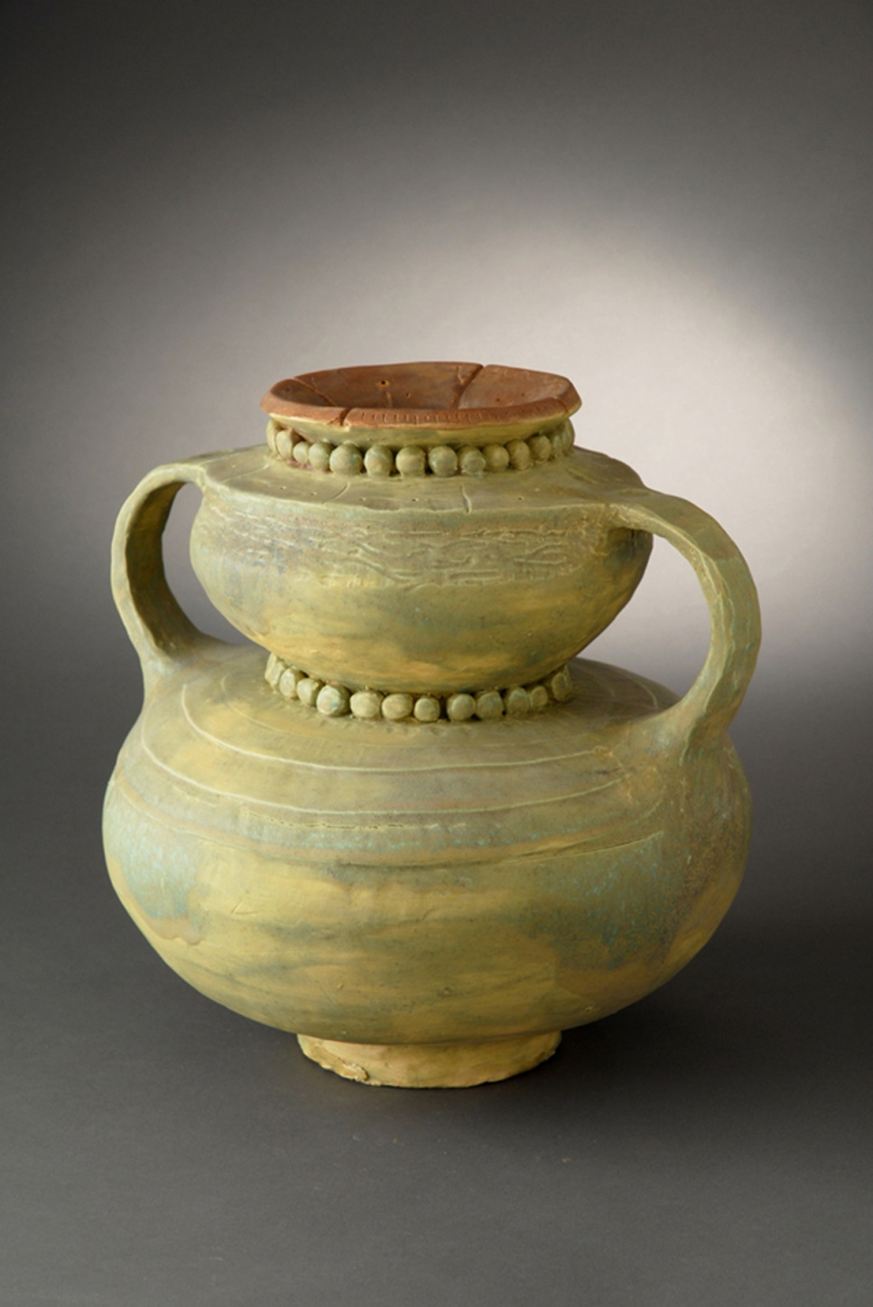
Adrienne Howett

Slide 27
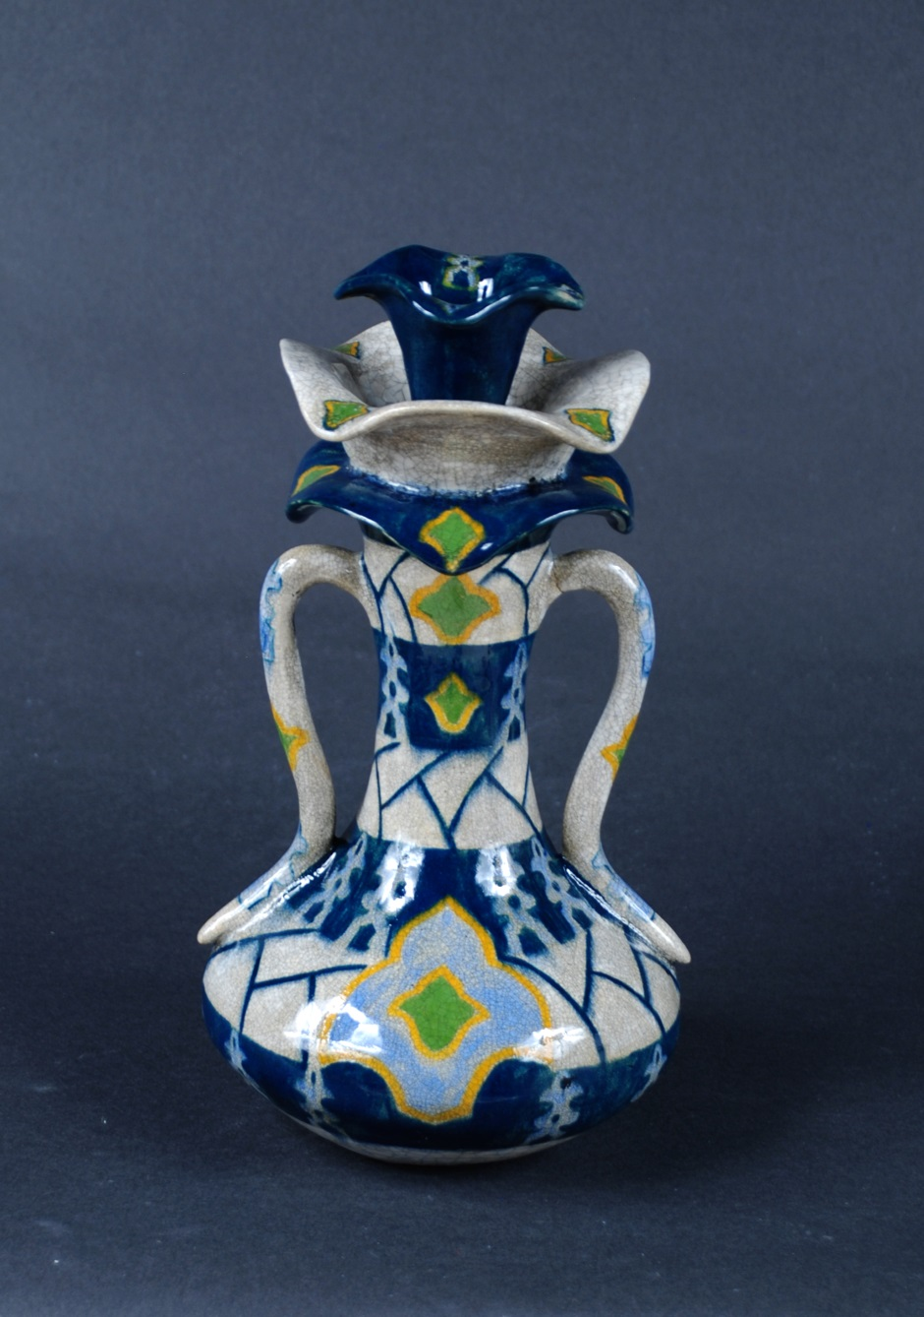
Tiffany Shrom

Slide 28
Cayla Robinson

Slide 29
Art department- highlights
Trips
Clubs/Honor Society/Art Advisory
Competitions/awards
Fine Arts Night
National Recognition
Scholarship

Slide 30
Business Electives
Intro to Business
Intro to economics, marketing, entrepreneurship, accounting, and personal finance
Learn to manage checking account, use credit, file income tax returns, develop a budget, and invest
Graphic Design, Advanced Graphic Design
Split into two semesters, register for both
Make publications to promote and advertise
Learn how to use software and do layouts
AP Computer Science Principle – REQUIRES RECOMMENDATION

Slide 31
Business Department- Highlights
FBLA- Future Business Leaders of America
Competitions
Trips
Opportunities
Women in Business
Available to female juniors
Mentorship

Slide 32
Family and Consumer Science Elective
Life Skills
Topics of Study include:
Character development and goal setting
Relationship skills
Managing resources- time, money, credit
Consumer literacy- value of money, consumer rights
Basic nutrition and kitchen/cooking basics
Sewing- pattern, fabrics, equipment, basic project
Good course for ANY student!

Slide 33
World Language Electives
Spanish I
French I
Both courses require daily practice and studying. They are academic, college-prep courses.
Students MUST take at least two years to be accepted to most 4-year schools. Some prefer 3 years.
Students may choose to start taking a language in 10th grade, but they limit their options later if they wait. Students taking advanced courses are usually fine to take a language in 9th grade. Students who struggle with work completion and studying may choose to wait.

Slide 34
Language Department- Highlights
Spanish Honor Society
Spanish Advisory Tutoring
Advanced levels as the years progress
Trips
Opportunities in the future

Slide 35
Music Electives
Band
Must do Band Camp in the summer
Marching, concert, football games
Can do Band AND Chorus if you don’t want to choose- Band MWF, Chorus TTh
Orchestra
No auditions for strings but wind and percussion need to audition
Chorus
Last period of the day
No tryouts
Piano Keyboarding
No previous keyboarding or piano skills

Slide 36
Music Department- Highlights
Opportunity to interact with upperclassmen
Events- football games, parades, concerts, etc.
Opportunities to try out for other involvements such as chorale, jazz band, etc.

Slide 37
Technology Electives
Courses:
Design Engineering
Manufacturing Systems
Video Production
Graphic Communications
CADD
Video:
https://www.youtube.com/watch?v=ybK0fnFjBLE

Slide 38
Technology Department Highlights
Real-life application projects
Set Design for Play/Musical, Community Projects
Use of Advanced Software and Materials
3-D printer, movie/tv studio
Media Club
Independent Studies in Senior Year
Preparation for CTC programs

Slide 39
Others…
Students in the Extensions Program:
Gifted Explorations
Gifted Applications
Solanco Virtual Academy:
If you have questions about our online program, please contact the appropriate counselor.
SVA is not available for advancement of credits or replacement of individual courses.

Slide 40
Miscellaneous information
No teacher requests
Making up classes
Changing electives/changing classes
Using the Educational Planning Guide and 4-Year Planning
Preparing for the transition to high school
Homework ****
Studying ****
Orientation over the summer
Ask questions!

Slide 41
Questions?

Slide 42
Thank you for coming!
Please contact Mrs. DeSimone/Mrs. Pearson with questions specific to your child’s course planning. You may also set up a time to meet with her.
We look forward to working with you this summer and next year!
Caitlin DeSimone
(717) 786-2244
caitlin_desimone@solancosd.org
Jennifer Pearson:
(717) 548-2187
jennifer_pearson@solancosd.org
All materials are also available on counselor websites for your reference.

