Slide 1
High School Course Selection for 11th Grade Courses
Presented by Mrs. Shumaker

Slide 2
Graduation Requirements
English can be one of the more important credits to capture each year.
4 English
3 Math
3 Science
3 History
1 Extra Core
1.5 PE Credits
.5 Health
10 Electives
26 Total Credits

Slide 3
Grade Level
Grade level is determined by the amount of credits a student starts the year with according to the following chart:
Grade 10: 5 Credits
Grade 11: 12 Credits
Grade 12: 19+ Credits
Students are scheduled for 7 Credits each year usually including 1 English, 1 Math, 1 Science, 1 History, and a combination of PE and Elective Credits.

Slide 4
Language as an Elective
Language courses are not required for graduation.
If you are considering yourself to be college-bound, you may want to consider taking a language if not done so already.
Competitive college-bound seniors expect to have completed at least two consecutive high school credits of a language.
Language offerings: Spanish or French.
Q: What does consecutive mean?

Slide 5
Prerequisites
Pre-requisites work like the foundation of a building.
In many instances, students must complete foundational courses before moving into more complex courses.
Examples: French/Spanish 1 before French/Spanish 2, Child Development 1 before Child Development 2, Nutrition 1 before Foreign Foods.
Pre-Calc.
Trigonometry
Pre-Calc.
Pre-Calc.
Trigonometry
Pre-Calc.
Algebra 2
Geometry
Algebra 2
Geometry
Algebra 2
Geometry
Algebra 2
Algebra 1
Algebra 1
Algebra 1
Algebra 1
Algebra 1
Algebra 1
Algebra 1

Slide 6
Advanced Courses and AP Courses
Teachers will recommend specific students for more challenging courses. Student who are interested in more challenging courses should schedule an appointment with their counselor.
Please understand there are certain requirements which need to be met prior to being scheduled in an Advanced or AP Course.
AP stands for Advanced Placement and is a trademark through the College Board. AP courses are very challenging and rigorous.

Slide 7
Final Grades
In full-year courses, earned credit is determined by passing 3 out of 5 of the following components: Quarters 1, 2, 3, 4, Final Grades and the average of midterm/final.
In half-year courses, earned credit is determined by passing 2 out of 3 of the following components: First and Second Quarter Final Grades and the Final.
Solanco’s Grading Policy is explained on page 28 of your passbook

Slide 8
Course Change Requests
Our goal is for you to have your schedule in your hand before summer break.
You will have a window over the summer to make request changes to your counselor.
Course change requests after this period will require parent approval, and will result in a DROP being recorded on the transcript.
A recorded DROP will reflect very poorly on a transcript, GPA, and Rank. In many ways, it’s better to attempt a course and receive a D than it is to drop.

Slide 9
Course Selection
Your CORE courses are selected based on progression from one class to another. For example, all first-year students complete English 1. All second year students complete World Literature.
You will make a selection based on which Electives interest you.
If you are a student with an Individualized Education Plan, your courses will be determined on a team basis. Please use this time to review the course catalog for elective courses that interest you.
TODAY: Students will log into PowerSchool and start to make their course selections. This class registration screen will be open until the end of February.
Parents/Guardians are encouraged to review course selections and reach out to their student’s counselor with questions.
Core Classes: English, Math, Science, and History

Slide 10
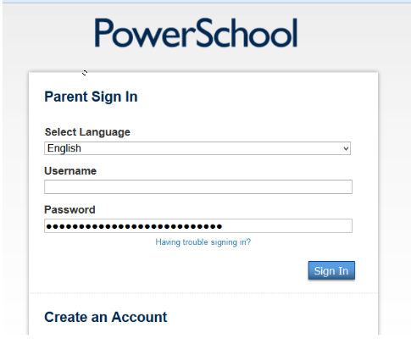
Step 1
Login to PowerSchool.
https://powerschool.solanco.k12.pa.us/public/

Slide 11
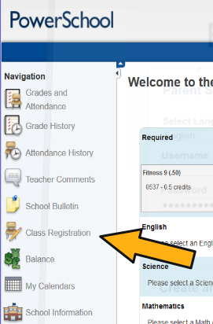
Step 2: Find the Button for Class Registration
It may look like this:

Slide 12
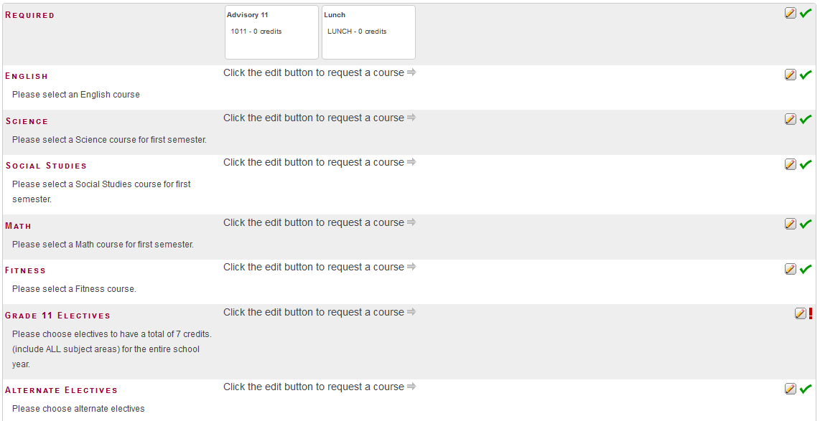
These numbers must match before this process is complete.

Slide 13
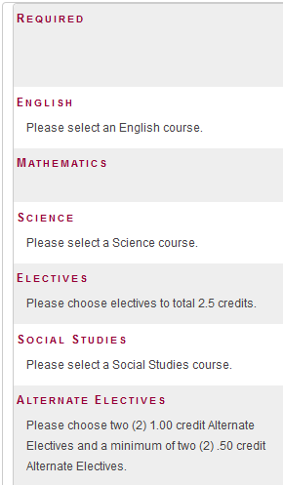
Step 3 – Review and Select Core Courses
Check all the green check boxes to be sure you are chosen for appropriate levels. If you disagree with your choice, talk to your teacher!

Slide 14
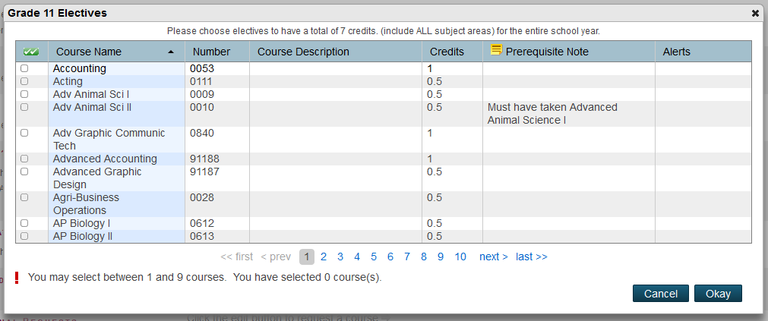
Step 4 – Choose your Top Elective Choices
You may not select more than 7 total credits.
These are loaded in alphabetic order. You must leaf page by page to find the one you want.

Slide 15
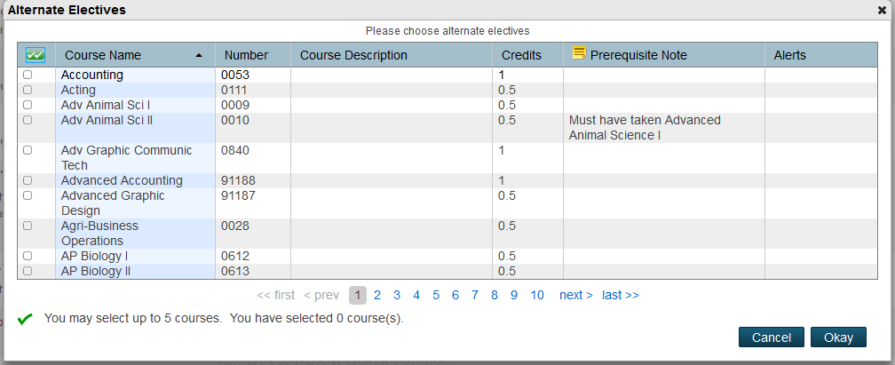
Step 5 – Choose Your Alternates.
PowerSchool will try its best to select your top choice based on all possible course combinations.
In the event that a course is not available during a time slot, it will use the Alternates to build your schedule. Please select meaningful alternates that you could live with in the event a top choice class is not available.

Slide 16
Please Raise Your Hand if you are stuck!
Post-Survey: https://tinyurl.com/SHScourseselection
You cannot close this out unless you select the correct amount of credits for electives and alternates.
Access will be closed by the end of February.
If you plan to attend the CTC, be sure that you schedule enough Fitness to be done.
Please follow up with your counselor if you think of any other questions.
Finish strong this year so that you can continue next year being awesome!
A Few Reminders:
This PowerPoint and other information is available on our website:
www.solancoguidance.weebly.com

